Slide 1
My Perimeter, Area and Volume Interactive Notebook
Name
Class
Term 3 Semester 2

Slide 2
Contents
Formula Page
Page
Date
Description
2
3

Slide 3
Tasks
24
7
30
Essential Question
Questions
Notes
Summary
10
11

Slide 4
24
7
30
Area
Date
EQ – How we can use formulas to find areas of different shapes?

Slide 5
Quick write.
What is area?
How is it measured?
When do we need area?

Slide 6
24
7
30
Area
Date
EQ – How we can use formulas to find areas of different shapes?
The area of a shape is the amount of space exists inside a 2 dimensional space.

Slide 7
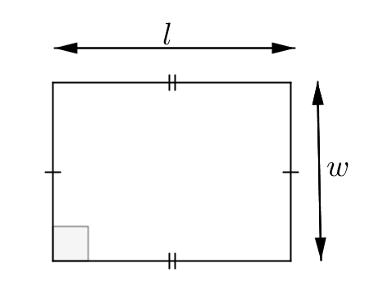
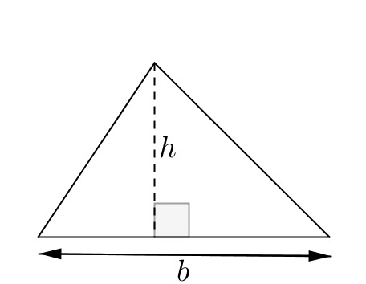
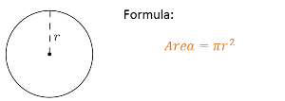
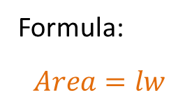

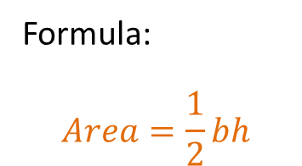
24
7
30
Area
Date
EQ – How we can use formulas to find areas of different shapes?
The area of a shape is the amount of space exists inside a 2 dimensional space. The 3 basic shapes are;
Area of a rectangle
Formula:
$$Area=lw$$
Formula:
$$Area=\frac{1}{2}bh$$
Area of a triangle
Area of circle
$$π≈3.14$$

Slide 8
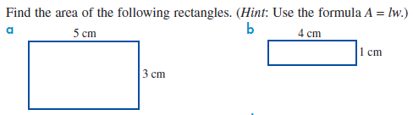
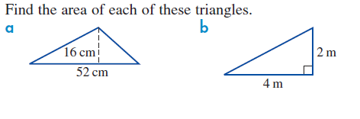
Examples
Let’s try together.
Find the area of these 2 circles.
2cm

Slide 9

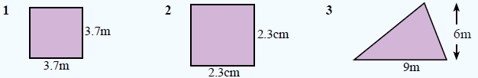
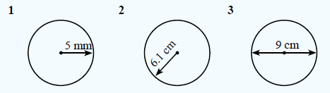
Your turn.
Use pi = 3.14

Slide 10
24
7
30
Area
Date
EQ – How we can use formulas to find areas of different shapes?
To find the area of complex shapes we can add together or remove the basic shapes
EG the shape below can be split into 2 pieces
7cm
20cm
5cm

Slide 11
24
7
30
Area
Date
EQ – How we can use formulas to find areas of different shapes?
To find the area of complex shapes we can add together or remove the basic shapes
EG the shape below can be split into 2 pieces
+
7cm
7cm
15cm
5cm
To find the area of the whole shape, we find the area of the 2 shapes and add them together.,
A=1/2 x base x height
= 0.5 x 7 x 5 cm
= 17.5 cm²
A=length x width
= 7 x 15 cm
= 105cm²
Total area = area of rect. + area of triangle
= 105 + 17.5 = 122.5cm²

Slide 12
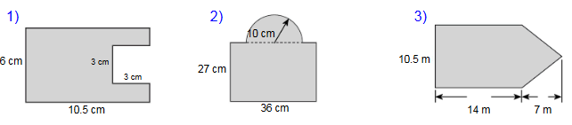

Slide 14
24
7
30
Area
Date
EQ – How we can use formulas to find areas of different shapes?
The area of a shape is the amount of space exists inside a 2 dimensional space. The 3 basic shapes are;
Area of a rectangle
Formula:
$$Area=lw$$
Formula:
$$Area=\frac{1}{2}bh$$
Area of a triangle
Area of circle
$$π≈3.14$$

Slide 15
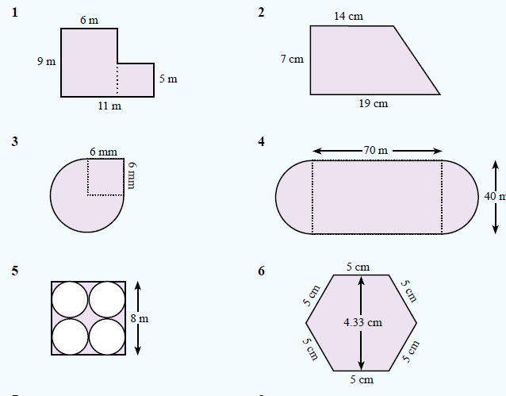
Complete ex 13.2 from Text.

